Slide 1
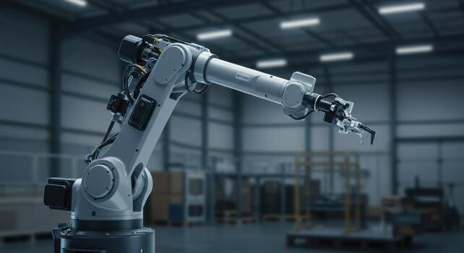
ARM O BOT
Student Name 1 : Prizen Balar
Enrollment No. : 2401151002
Student Name 2 : Ketul Patel
Enrollment No. : 2401151082

Slide 2
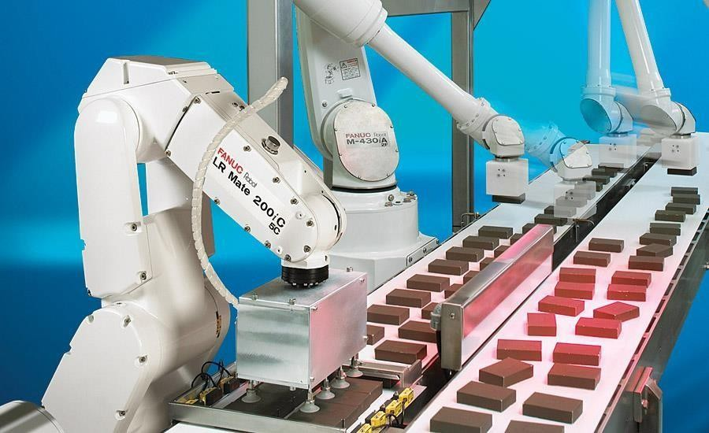
Introduction – ARM O BOT
The aim of this project is to develop a robotic arm control system that can perform pick-and-place operations using saved positions. The system is flexible and can be used with different types of robotic arms.
Fig: Robotic arm used for pick and place application

Slide 3
Methodology
The project consists of different kinds of domains, such as:
Kinematics and Dynamics: to calculate end-effector trajectory and other manipulation
Forward and reverse kinematics
Dynamics: consists of force and torque measurements
3D Prototyping:
3D modelling
3D printing
Electronics and Communication Systems: for actuation and remote communication
Circuit designing
Microcontroller programming

Slide 4
Technologies Used
Programming:
Python API is used for robotic arm manipulation
Python 3.12
Microcontroller Programming:
MicroPython
ESP32
Web Technologies:
HTML
CSS
JavaScript
Communication:
Wi-Fi communication
HTTP requests
Robotic Arm Control:
Servo motor control
Saved position control
Pick-and-place movement logic

Slide 5
System Architecture
Robot Vision
Hardware
Software
Mechanical Design
Electronics
Inverse Kinematics
Frontend
3D Printing
3D Design
Microcontroller and PCB Design

Slide 6
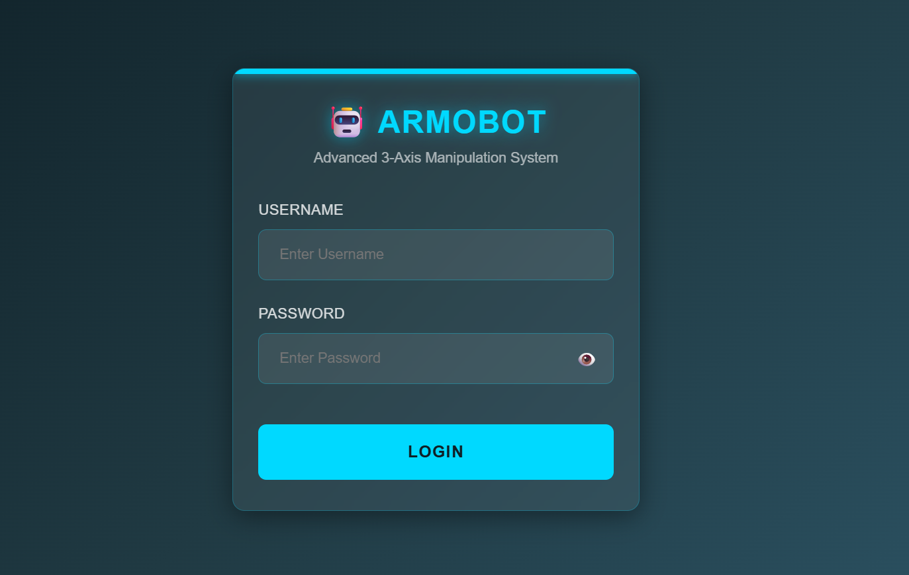
Login Interface
Login Method:
Email and Password Login
Interface Features: User authentication system Input: Username & Password Password visibility toggle (👁️) Connected to database for verification Access control for robotic arm
Database (Authentication): XAMPP and MySQL are used to store user credentials (username & password). Database verifies login details to allow secure access. Only authorized users can control the robotic arm system

Slide 7
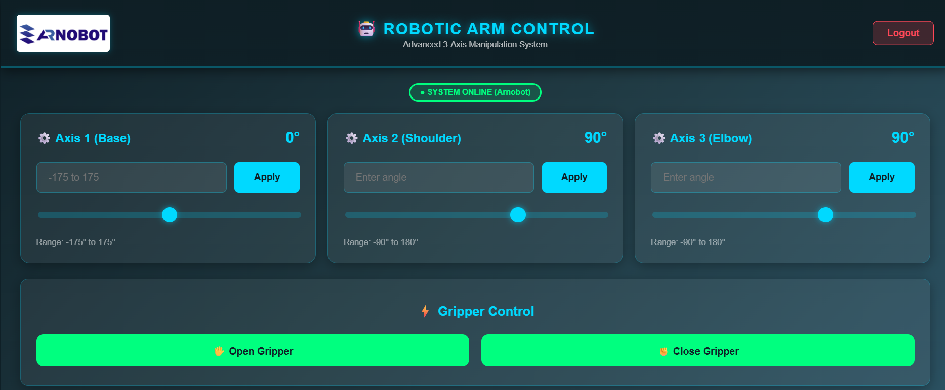

🤖 Control Dashboard:
System Status: System online/offline indicator
Axis Control: 3-Axis control (Base, Shoulder, Elbow) Manual angle input Apply command button
Gripper Control: Open gripper Close gripper
Calibration: Initialize robotic arm position
Position Memory: Save Position 1 & 2 Recall saved positions
Automation: Execute pick & place operation

Slide 8
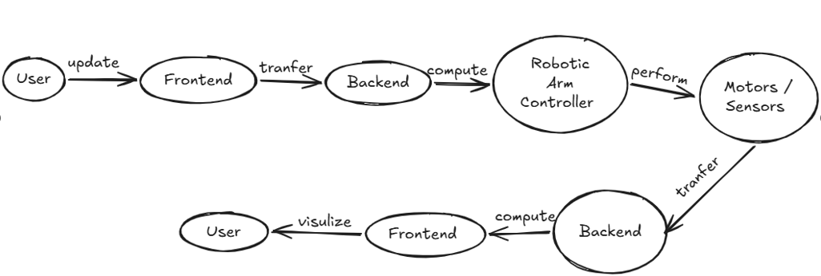
Data flow Diagram

Slide 9
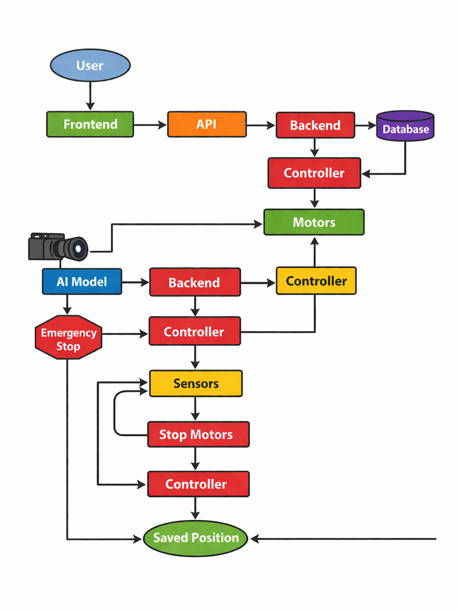
Activity Diagram

Slide 10
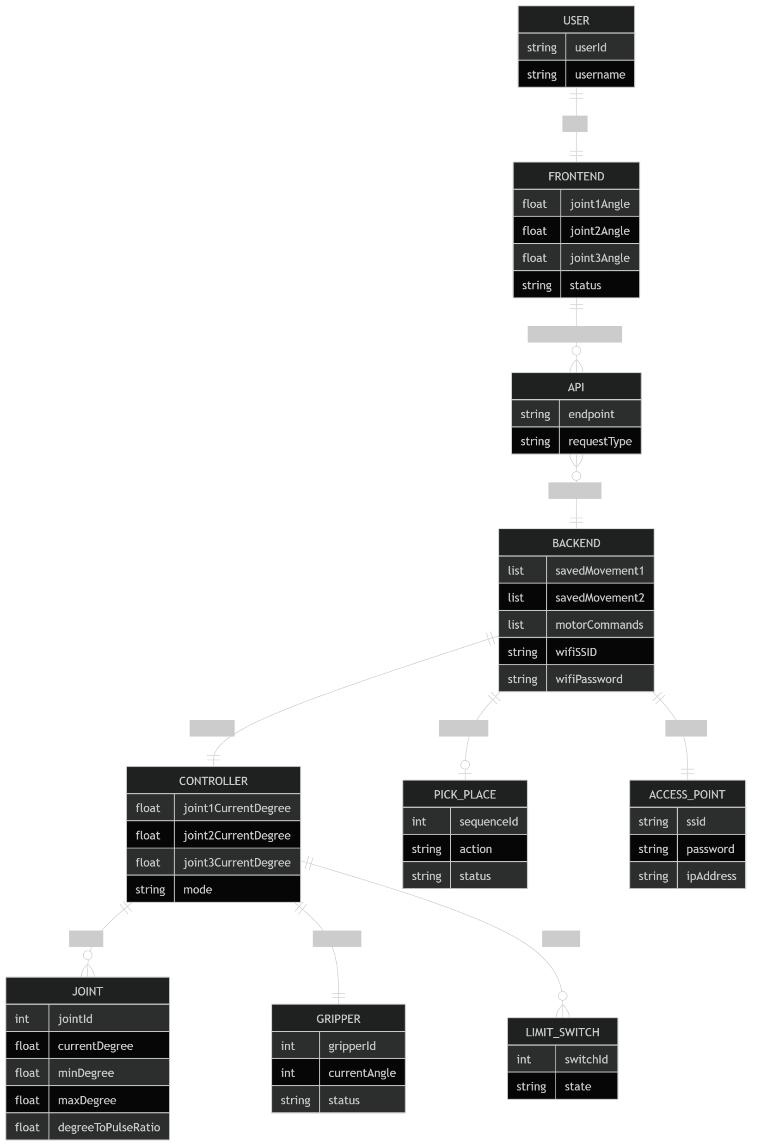
ER Diagram

Slide 11
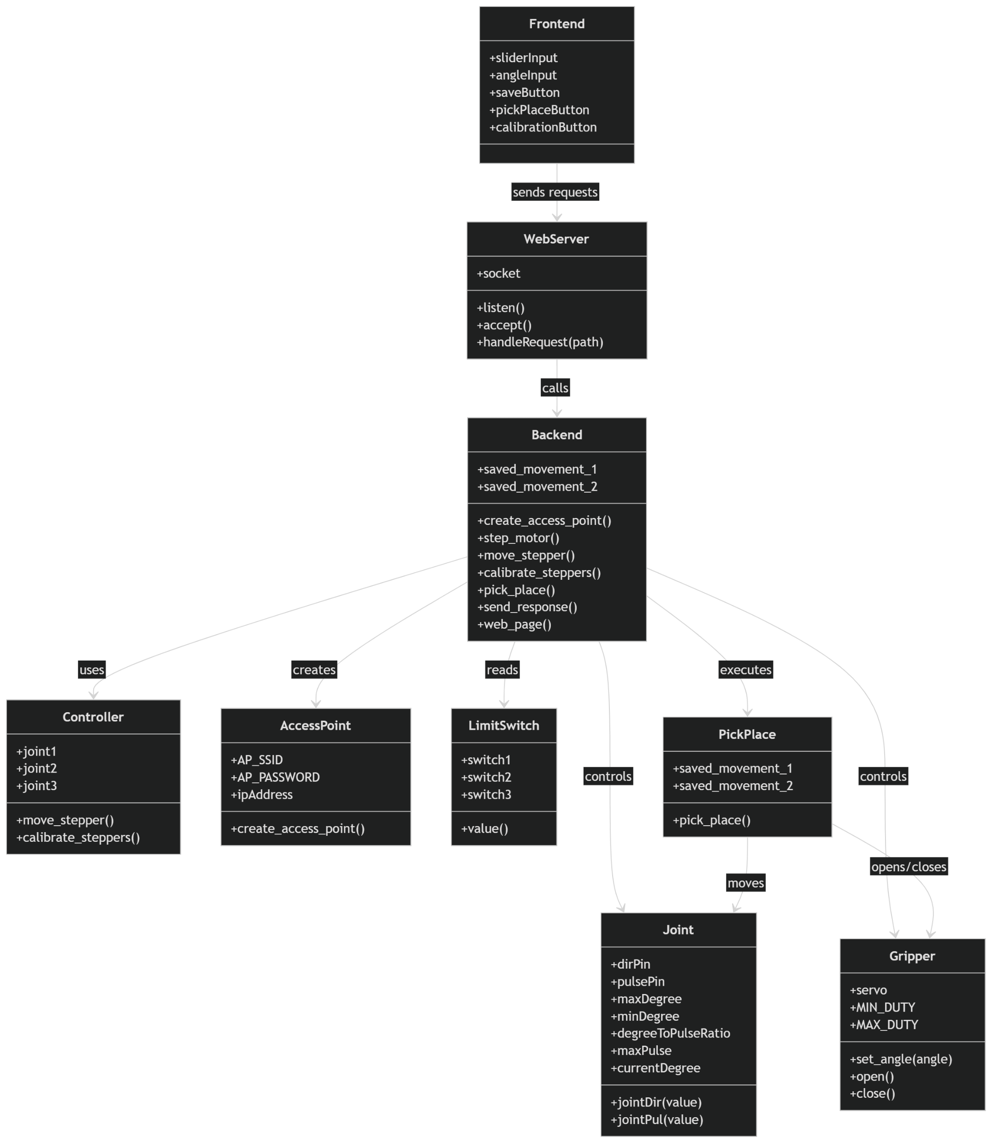
Class Diagram

Slide 12
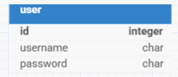
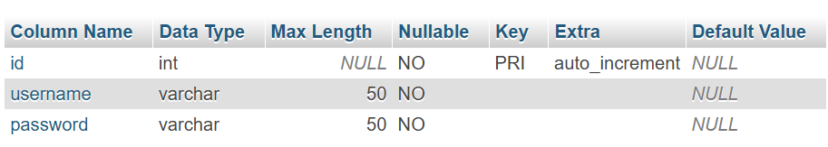
Database Design
Data Dictionary

Slide 13
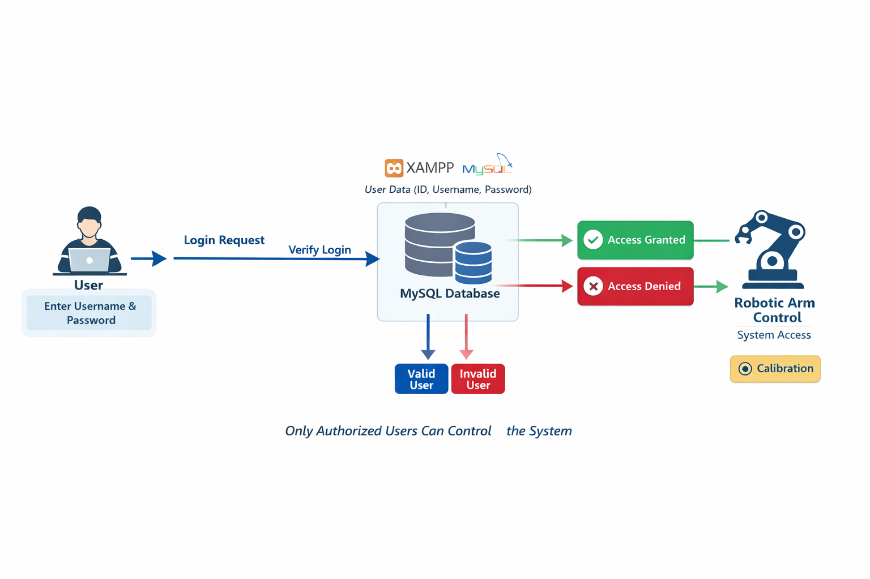
System Flow Diagram
This diagram shows the authentication flow using XAMPP and MySQL. User credentials are verified, and only authorized users can access the robotic arm system. After login, operations like control and calibration are performed.

Slide 14
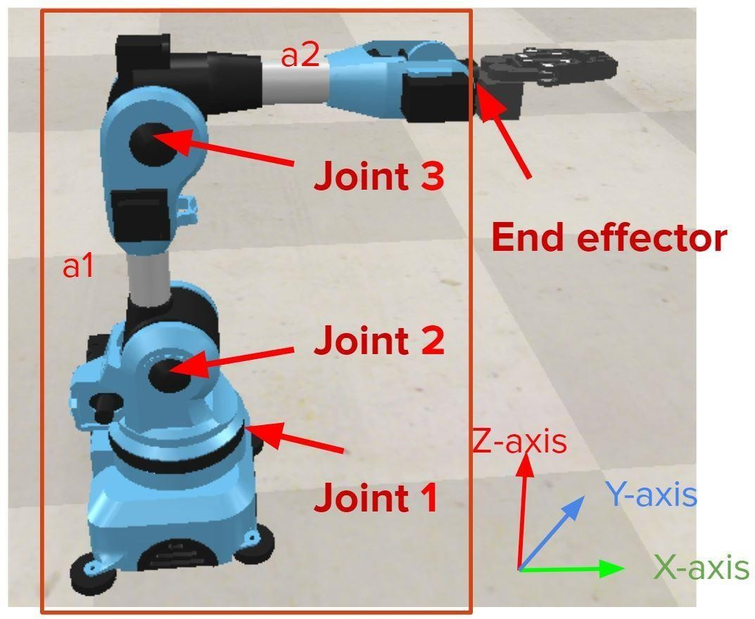
Inverse Kinematics - Position
For position 3 joints are responsible
Joint1, joint2, joint3
Using trigonometry and cosine laws these angles are calculated
The calculated joint angles are as follows:
r1 = (z²+x² )^{1/2}
Theta2 = tan-1(z/x) + cos-1((a1² +r1² - a22)/ 2a1r1)
Theta3 = -(cos-1((a1² +a2² - r22)/ 2a1a2) *180/3.14 - 90
Theta1 = tan-1(y/x)

Slide 15
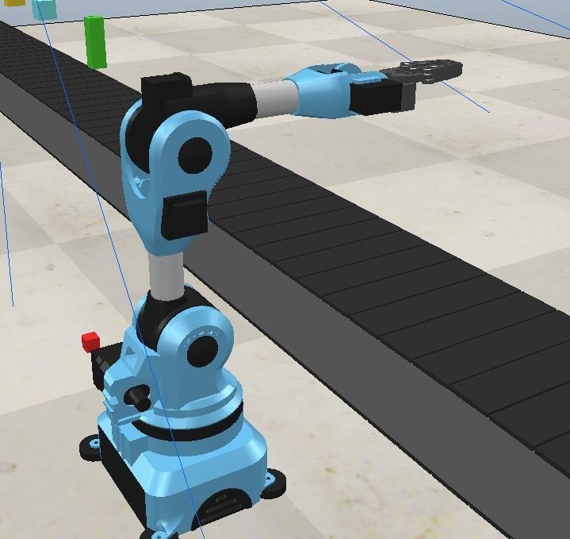
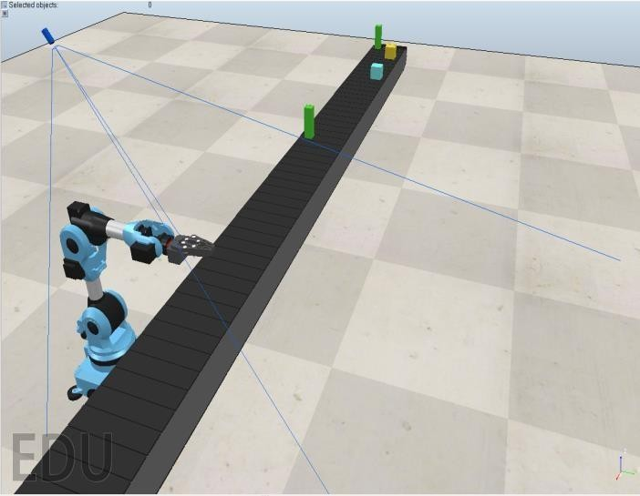
Simulation
To implement a basic simulation setup
Save robotic arm positions and movements
Manipulate the robot to perform pick-and-place operations
Repeat the same movement based on saved positions and commands

Slide 16
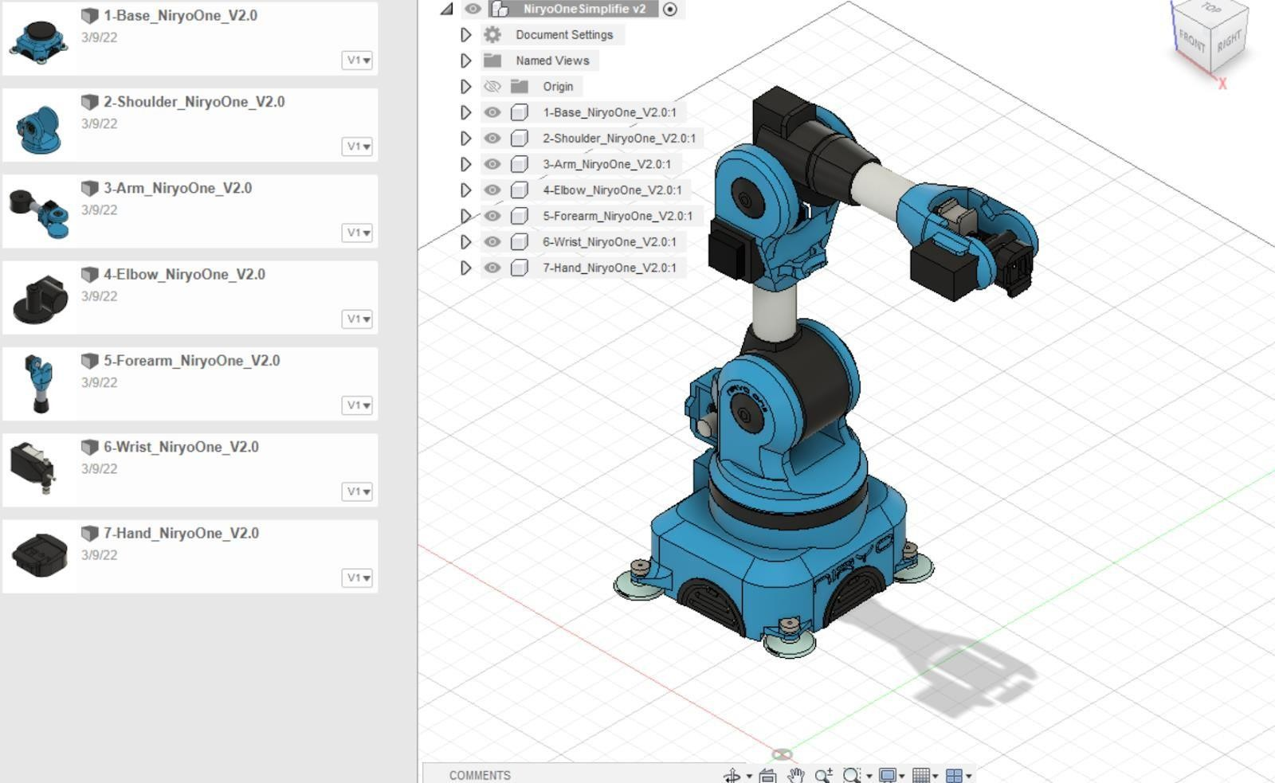
Prototyping Design

Slide 17
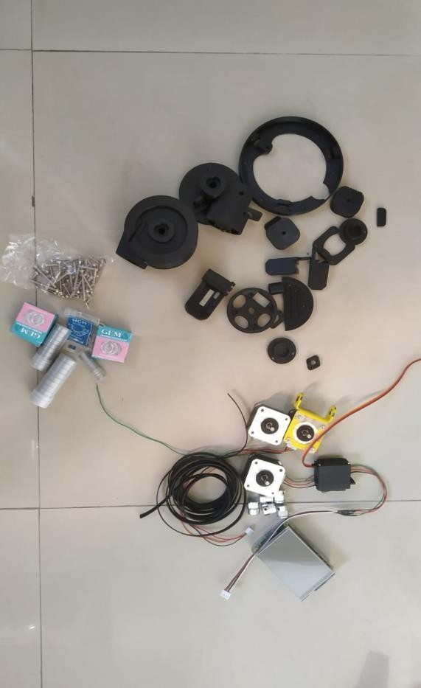
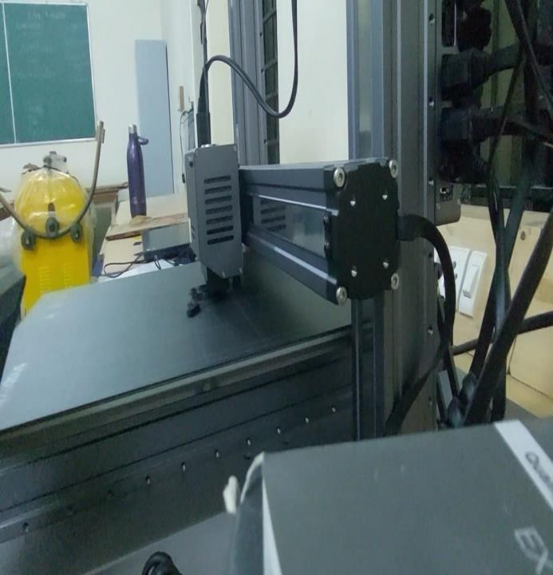
3D Printing Parts

Slide 18
Use Cases and Real-World Applications
Industrial pick-and-place operations in factories
Sorting products in warehouses
Automated packaging systems
Laboratory sample handling
Restaurant food serving and object delivery
Hospital medicine or tool handling
Loading and unloading small items on conveyor belts

Slide 19
Result and conclusion
The robotic arm control system was successfully implemented.
The robotic arm can perform pick-and-place operations using saved positions.
The system can repeat movements automatically for similar tasks.
The project combines robotics, web control, electronics, and microcontroller programming.
This project demonstrates the feasibility of automated robotic arm operation.
You can find on https://github.com/prijenbalar/Robot-Vision with the code and documentation.

Slide 20
References
Niryo Robotic Arm Website
https://niryo.com/
Coppelia Robotics Simulation Software Website
https://www.coppeliarobotics.com/
Inverse Kinematics References
Guide for Inverse Kinematics for 6-DOF Robot Arms
https://automaticaddison.com/the-ultimate-guide-to-inverse-kinematics-for-6dof-robot-arms/
Kinematics Analysis of 6-DoF Articulated Robot with Spherical Wrist
Inverse Kinematics for 6-DOF Manipulator by the Method of Sequential Retrieval
Asynchronous I/O Reference
Github Repository
https://www.youtube.com/watch?v=t5Bo1Je9EmE
https://github.com/prijenbalar/Robot-Vision

Slide 21

Scan to view the simulation video. Feel free to ask any questions. Happy to help 😃

Slide 22



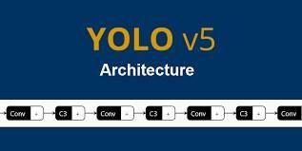


Happy to reply 😃

